Slide 1



Maternal Mortality: A Global Challenge
Maternal mortality remains a significant public health concern in developing countries, contributing to preventable deaths of mothers and newborns.
by Robert Njuguna

Slide 2
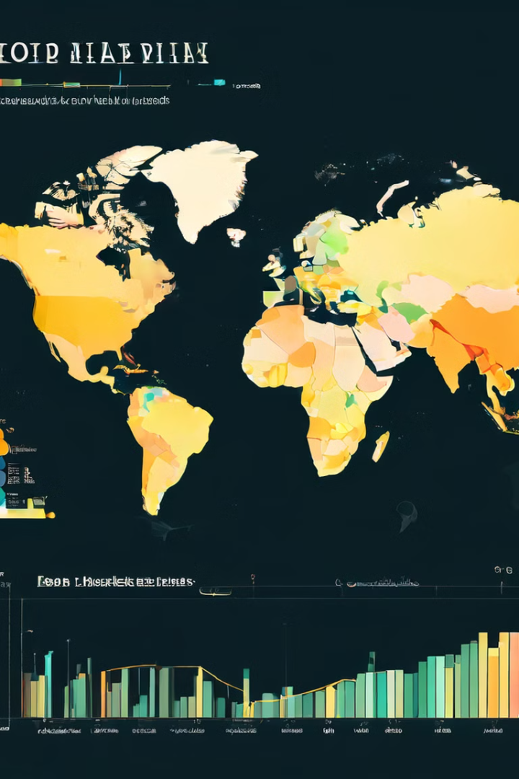
Maternal Mortality Rates in Developing Countries
1
High Rates
2
Contributing Factors
Developing countries experience significantly higher maternal mortality rates than developed nations, impacting families and communities.
Poverty, lack of access to quality healthcare, limited education, and cultural practices contribute to the high maternal mortality rates in developing countries.
3
Regional Variations
4
Long-Term Impacts
Maternal mortality rates vary significantly across different regions, highlighting the need for tailored interventions and solutions.
Maternal deaths leave a lasting impact on families and communities, exacerbating poverty and hindering economic development.

Slide 3
Improving Access to Quality Prenatal Care
Early Detection
Health Education
Disease Prevention
Regular prenatal visits enable early identification of potential health risks, allowing for timely intervention and improved maternal and infant health.
Prenatal care provides essential health education on nutrition, hygiene, and childbirth preparation, empowering women to make informed decisions about their health.
Prenatal care includes screenings and vaccinations to prevent common pregnancy complications, such as anemia, infections, and pre-eclampsia.

Slide 4




Increasing Skilled Birth Attendance
Reducing Complications
Skilled birth attendants possess the necessary expertise and training to identify and manage pregnancy and childbirth complications.
Emergency Response
They can provide timely and effective medical interventions, such as cesarean sections and blood transfusions, in case of emergencies.
Improved Outcomes
Skilled birth attendance significantly reduces maternal and newborn mortality rates, leading to healthier mothers and babies.

Slide 5

Proposed Solution
1
Data Collection
A comprehensive relational database will be designed to collect detailed information on prenatal care visits, birth outcomes, and maternal mortality rates.
2
Data Analysis
The database will facilitate analysis of trends, identifying areas with high maternal mortality rates and areas requiring improved healthcare access.
3
Intervention Strategies
Data insights will guide targeted interventions, including training healthcare professionals, promoting awareness campaigns, and improving healthcare infrastructure.

Slide 6

Relational Database Design
Table
Columns
Relationships
Patient
Patient ID, Name, Age, Address, Contact Information
One-to-many with Prenatal Care Visits, One-to-many with Births
Prenatal Care Visits
Visit ID, Patient ID, Date, Gestational Age, Blood Pressure, Weight, Health Concerns
Many-to-one with Patient
Births
Birth ID, Patient ID, Date, Birth Weight, Delivery Method, Complications, Birth Outcome
Many-to-one with Patient
Maternal Deaths
Death ID, Patient ID, Date, Cause of Death, Location
Many-to-one with Patient

Slide 7





Data Tracking and Analysis
Trends Analysis
Geographical Mapping
Regular data tracking enables monitoring of trends in maternal health indicators, identifying patterns and areas for improvement.
Mapping data geographically reveals hotspots with high maternal mortality rates, facilitating targeted interventions.
Progress Reporting
Early Warning System
Regular reporting on data trends allows for evaluation of program effectiveness and identification of areas for adjustments.
Data analysis can identify potential health risks early, enabling timely intervention and potentially preventing maternal deaths.

Slide 8
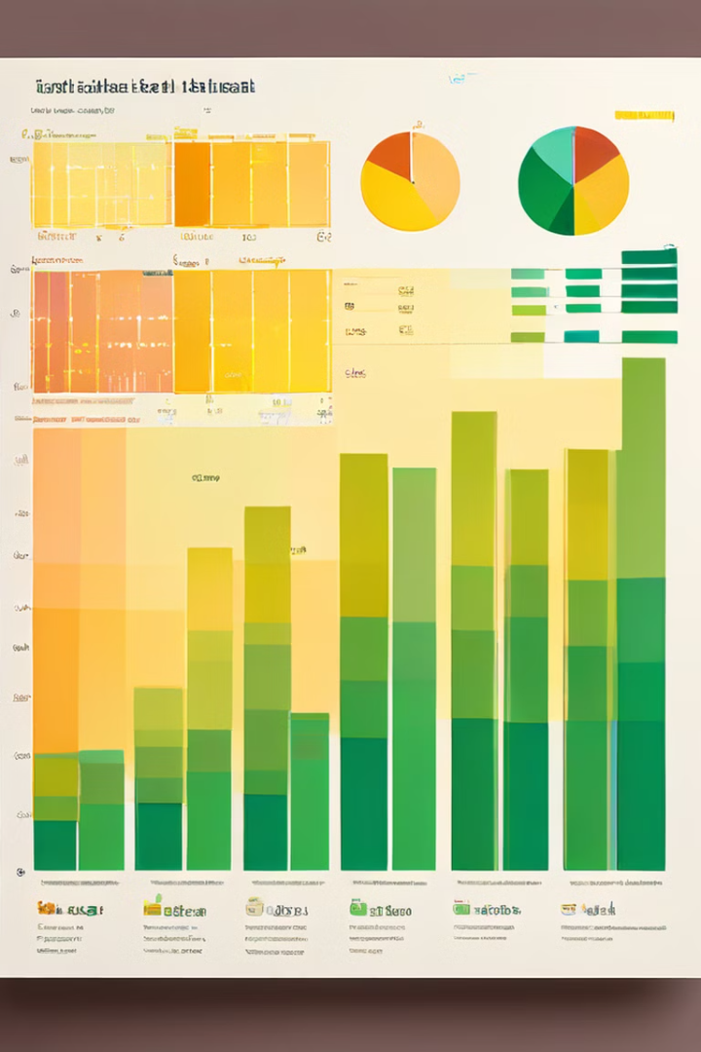
Microsoft Excel for Data Visualization
Interactive Charts
Data Filtering
Excel's charting capabilities provide interactive visualizations, allowing for data exploration and analysis.
Excel offers powerful filtering options, enabling users to segment data and focus on specific regions or demographics.
Data Summarization
Report Generation
Excel's summarization functions, such as pivot tables, allow for efficient data analysis and identification of key insights.
Excel facilitates the creation of visually appealing reports, enabling effective communication of data findings to stakeholders.

